Slide 1
Hierarchical structure
Nick Riches
Homework
Hierarchical Str
Hier.Sent.Str. Hier.Phr.Str. Embedding Hier. word str.
Hierarchical structure
Syn. Ambiguity
Syn. Ambiguity
Nick Riches
Movement
Emb. phrases
Newcastle University
Recursion
What is recursion? Examples of recursion Characteristics of recursion Why do we need recursion?
Compiled on February 12, 2020
Adv. of trees
Advantages
Trees and UG
Ideas of NC Pov. stim. UG and trees
The UG debate
Imp of rec.
Lang without rec.? Recursion in other domains? Presence of multi¹ple^{/ 37}

Slide 2
Hierarchical structure
Nick Riches
Homework
Hierarchical structure Syntactic ambiguity
Homework
Hierarchical Str
Hier.Sent.Str. Hier.Phr.Str. Embedding Hier. word str.
Movement Recursion
The advantages of trees
Syn. Ambiguity
Syn. Ambiguity
Movement
Emb. phrases
Recursion
What is recursion? Examples of recursion Characteristics of recursion Why do we need recursion?
Trees and Chomsky’s Universal Grammar
Adv. of trees
Advantages
The Universal Grammar debate
Trees and UG
Ideas of NC Pov. stim. UG and trees
Universal Grammar theories of language impairment
Bibliography
The UG debate
Imp of rec.
Lang without rec.? Recursion in other domains? Presence of multi¹ple^{/ 37}

Slide 3
Hierarchical structure
Nick Riches
Homework
Hierarchical Str
Hier.Sent.Str. Hier.Phr.Str. Embedding Hier. word str.
What are the two meanings of I’m a big dog man?
Syn. Ambiguity
Syn. Ambiguity
Movement
Emb. phrases
Recursion
What is recursion? Examples of recursion Characteristics of recursion Why do we need recursion?
Adv. of trees
Advantages
Trees and UG
Ideas of NC Pov. stim. UG and trees
The UG debate
Imp of rec.
Lang without rec.? Recursion in other domains? Presence of multi²ple^{/ 37}

Slide 4
Hierarchical structure
Nick Riches
Homework
Hierarchical Str
Hier.Sent.Str. Hier.Phr.Str. Embedding Hier. word str.
What are the two meanings of I’m a big dog man?
Syn. Ambiguity
Syn. Ambiguity
I’m a man who likes big dogs (‘big’ = LARGE)
I’m a man who is keen on dogs (‘big’ = KEEN)
Movement
Emb. phrases
Recursion
What is recursion? Examples of recursion Characteristics of recursion Why do we need recursion?
Adv. of trees
Advantages
Trees and UG
Ideas of NC Pov. stim. UG and trees
The UG debate
Imp of rec.
Lang without rec.? Recursion in other domains? Presence of multi²ple^{/ 37}

Slide 5
Hierarchical structure
Nick Riches
Homework
Hierarchical Str
Hier.Sent.Str. Hier.Phr.Str. Embedding Hier. word str.
What are the two meanings of I’m a big dog man?
Syn. Ambiguity
Syn. Ambiguity
I’m a man who likes big dogs (‘big’ = LARGE)
I’m a man who is keen on dogs (‘big’ = KEEN)
Movement
Emb. phrases
Recursion
What is recursion? Examples of recursion Characteristics of recursion Why do we need recursion?
Each different meaning corresponds to a different syntactic structure.
Adv. of trees
Advantages
Trees and UG
Ideas of NC Pov. stim. UG and trees
The UG debate
Imp of rec.
Lang without rec.? Recursion in other domains? Presence of multi²ple^{/ 37}

Slide 6
Hierarchical structure
Nick Riches
Homework
Hierarchical structure Syntactic ambiguity
Homework
Hierarchical Str
Hier.Sent.Str. Hier.Phr.Str. Embedding Hier. word str.
Movement Recursion
The advantages of trees
Syn. Ambiguity
Syn. Ambiguity
Movement
Emb. phrases
Recursion
What is recursion? Examples of recursion Characteristics of recursion Why do we need recursion?
Trees and Chomsky’s Universal Grammar
Adv. of trees
Advantages
The Universal Grammar debate
Trees and UG
Ideas of NC Pov. stim. UG and trees
Universal Grammar theories of language impairment
Bibliography
The UG debate
Imp of rec.
Lang without rec.? Recursion in other domains? Presence of multi²ple^{/ 37}

Slide 7
Hierarchical sentence structure
Hierarchical structure
Nick Riches
Homework Hierarchical Str
Hier.Sent.Str. Hier.Phr.Str. Embedding Hier. word str.
Syn. Ambiguity
Syn. Ambiguity
(1) The man _{VP} [avidly watched _{NP} [the documentary on penguins] ]
Movement
Emb. phrases
Recursion
What is recursion? Examples of recursion Characteristics of recursion Why do we need recursion?
Adv. of trees
Advantages
Trees and UG
Ideas of NC Pov. stim. UG and trees
The UG debate
Imp of rec.
Lang without rec.? Recursion in other domains? Presence of multi³ple^{/ 37}

Slide 8
Hierarchical sentence structure
Hierarchical structure
Nick Riches
Homework
Hierarchical Str
Hier.Sent.Str. Hier.Phr.Str. Embedding Hier. word str.
Sentence
Syn. Ambiguity
Syn. Ambiguity
NP
VP
Movement
Emb. phrases
Recursion
What is recursion? Examples of recursion Characteristics of recursion Why do we need recursion?
Det N Verb Complex
NP
Adv. of trees
Advantages
The man avidly watched the documentary on penguins
Trees and UG
Ideas of NC Pov. stim. UG and trees
The UG debate
Imp of rec.
Lang without rec.? Recursion in other domains? Presence of multi⁴ple^{/ 37}

Slide 9
Hierarchical phrase structure
Hierarchical structure
Nick Riches
Homework
The _{NP} [documentary _{PP} [on [_{NP} Penguins] ] ]
Hierarchical Str
Hier.Sent.Str. Hier.Phr.Str. Embedding Hier. word str.
NP
Syn. Ambiguity
Syn. Ambiguity
Det
N
Movement
Emb. phrases
Recursion
What is recursion? Examples of recursion Characteristics of recursion Why do we need recursion?
the
N
PP
documentary P NP
Adv. of trees
Advantages
Trees and UG
Ideas of NC
on penguins
(2)
Pov. stim.
UG and trees
The UG debate
Imp of rec.
Lang without rec.? Recursion in other domains? Presence of multi⁵ple^{/ 37}

Slide 10
Embedding
Hierarchical structure
Nick Riches
Homework
Hierarchical Str
Hier.Sent.Str. Hier.Phr.Str. Embedding Hier. word str.
Embedding of one phrase inside another
If we move a phrase we have to move all embedded phrases.
label
Syn. Ambiguity
Syn. Ambiguity
Movement
It was [ the documentary [ on penguins]] that the man watched t ^{Emb. phrases}
NP PP
Recursion
What is recursion? Examples of recursion Characteristics of recursion Why do we need recursion?
label
*It was [the documentary] that the man loved t [on penguins]
Adv. of trees
Advantages
Trees and UG
Ideas of NC
Pov. stim. UG and trees
The UG debate
Imp of rec.
Lang without rec.? Recursion in other domains? Presence of multi⁶ple^{/ 37}

Slide 11
Hierarchical structure in words
Hierarchical structure
Nick Riches
Homework Hierarchical Str
Hier.Sent.Str. Hier.Phr.Str. Embedding Hier. word str.
un- touch -able -s
Syn. Ambiguity
Syn. Ambiguity
Movement
Emb. phrases
Recursion
What is recursion? Examples of recursion Characteristics of recursion Why do we need recursion?
Adv. of trees
Advantages
Trees and UG
Ideas of NC Pov. stim. UG and trees
The UG debate
Imp of rec.
Lang without rec.? Recursion in other domains? Presence of multi⁷ple^{/ 37}

Slide 12
Hierarchical structure in words
Hierarchical structure
Nick Riches
Homework Hierarchical Str
Hier.Sent.Str. Hier.Phr.Str. Embedding Hier. word str.
un- touch -able -s un- -s
un- -s
-s
Syn. Ambiguity
Syn. Ambiguity
root -able root suff. stem
Movement
Emb. phrases
Recursion
What is recursion? Examples of recursion Characteristics of recursion Why do we need recursion?
pref.
stem
suff.
Adv. of trees
Advantages
Trees and UG
Ideas of NC Pov. stim. UG and trees
The UG debate
Imp of rec.
Lang without rec.? Recursion in other domains? Presence of multi⁷ple^{/ 37}

Slide 13
Hierarchical structure in words
Hierarchical structure
Nick Riches
Homework
Hierarchical Str
Hier.Sent.Str. Hier.Phr.Str. Embedding Hier. word str.
Word
Stem
Suff.
Syn. Ambiguity
Syn. Ambiguity
Movement
Emb. phrases
Pref.
Stem
-s
Recursion
What is recursion? Examples of recursion Characteristics of recursion Why do we need recursion?
Un-
Root Suff.
Adv. of trees
Advantages
touch
-able
Trees and UG
Ideas of NC Pov. stim. UG and trees
The UG debate
Imp of rec.
Lang without rec.? Recursion in other domains? Presence of multi⁸ple^{/ 37}

Slide 14
Hierarchical structure
Nick Riches
Homework
Hierarchical structure Syntactic ambiguity
Homework
Hierarchical Str
Hier.Sent.Str. Hier.Phr.Str. Embedding Hier. word str.
Movement Recursion
The advantages of trees
Syn. Ambiguity
Syn. Ambiguity
Movement
Emb. phrases
Recursion
What is recursion? Examples of recursion Characteristics of recursion Why do we need recursion?
Trees and Chomsky’s Universal Grammar
Adv. of trees
Advantages
The Universal Grammar debate
Trees and UG
Ideas of NC
Universal Grammar theories of language impairment
Pov. stim.
UG and trees
Bibliography
The UG debate
Imp of rec.
Lang without rec.? Recursion in other domains? Presence of multi⁸ple^{/ 37}

Slide 15
Syntactic ambiguity in sentences
Hierarchical structure
Nick Riches
Homework Hierarchical Str
Hier.Sent.Str. Hier.Phr.Str. Embedding Hier. word str.
Syn. Ambiguity
Syn. Ambiguity
Multiple syntactic presentations
Movement
Emb. phrases
(3) I’m a big dog man
Recursion
What is recursion? Examples of recursion Characteristics of recursion Why do we need recursion?
Adv. of trees
Advantages
Trees and UG
Ideas of NC
Pov. stim.
UG and trees
The UG debate
Imp of rec.
Lang without rec.? Recursion in other domains? Presence of multi⁹ple^{/ 37}

Slide 16
Syntactic ambiguity in sentences
Hierarchical structure
Nick Riches
Homework
Hierarchical Str
Hier.Sent.Str. Hier.Phr.Str. Embedding Hier. word str.
NP
NP
Det
a Adj
Det a
Syn. Ambiguity
Syn. Ambiguity
NP
NP
NP
Adj N
Movement
Emb. phrases
NP
N
Recursion
What is recursion? Examples of recursion Characteristics of recursion Why do we need recursion?
big
N N
man
dog
man
big
dog
Adv. of trees
Advantages
Trees and UG
Ideas of NC Pov. stim. UG and trees
The UG debate
Imp of rec.
Lang without rec.? Recursion in other domains? Presence of mul¹ti⁰ple^{/ 37}

Slide 17
Syntactic ambiguity in sentences
Hierarchical structure
Nick Riches
Homework
Hierarchical Str
Hier.Sent.Str. Hier.Phr.Str. Embedding Hier. word str.
NP
NP
Det
a Adj
big N N
Det a
NP
NP
Syn. Ambiguity
Syn. Ambiguity
NP N
Adj N man
NP
Movement
Emb. phrases
Recursion
What is recursion? Examples of recursion Characteristics of recursion Why do we need recursion?
dog
man
big
dog
Keen on all dogs
Likes big dogs only
Adv. of trees
Advantages
Trees and UG
Ideas of NC Pov. stim. UG and trees
The UG debate
Imp of rec.
Lang without rec.? Recursion in other domains? Presence of mul¹ti¹ple^{/ 37}

Slide 18
Syntactic ambiguity in sentences
Hierarchical structure
Nick Riches
Homework Hierarchical Str
Hier.Sent.Str. Hier.Phr.Str. Embedding Hier. word str.
Another example
Syn. Ambiguity
Syn. Ambiguity
Movement
Emb. phrases
(4) The man saw the woman with the binoculars
Recursion
What is recursion? Examples of recursion Characteristics of recursion Why do we need recursion?
How is this ambiguous?
Adv. of trees
Advantages
Trees and UG
Ideas of NC Pov. stim. UG and trees
The UG debate
Imp of rec.
Lang without rec.? Recursion in other domains? Presence of mul¹ti²ple^{/ 37}

Slide 19
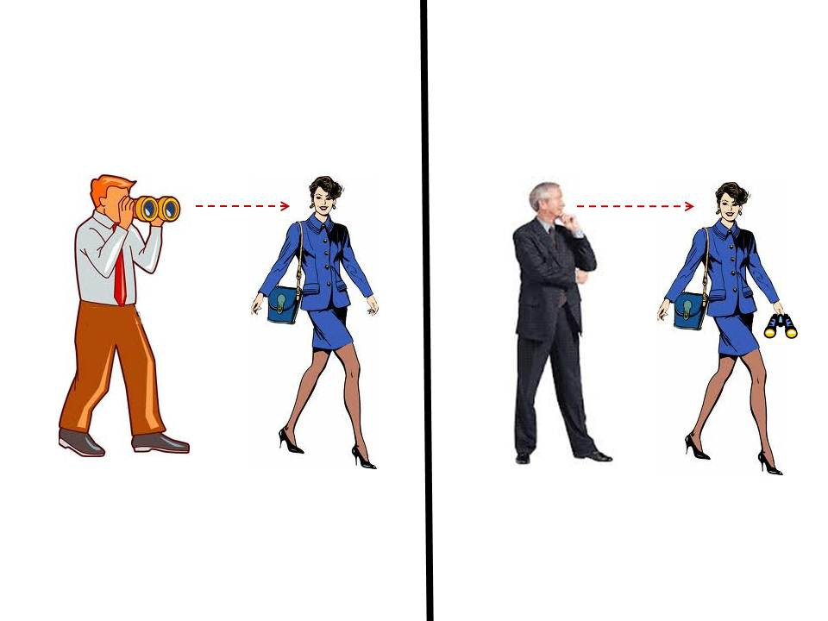
Syntactic ambiguity in sentences
The man saw the woman with the binoculars

Slide 20
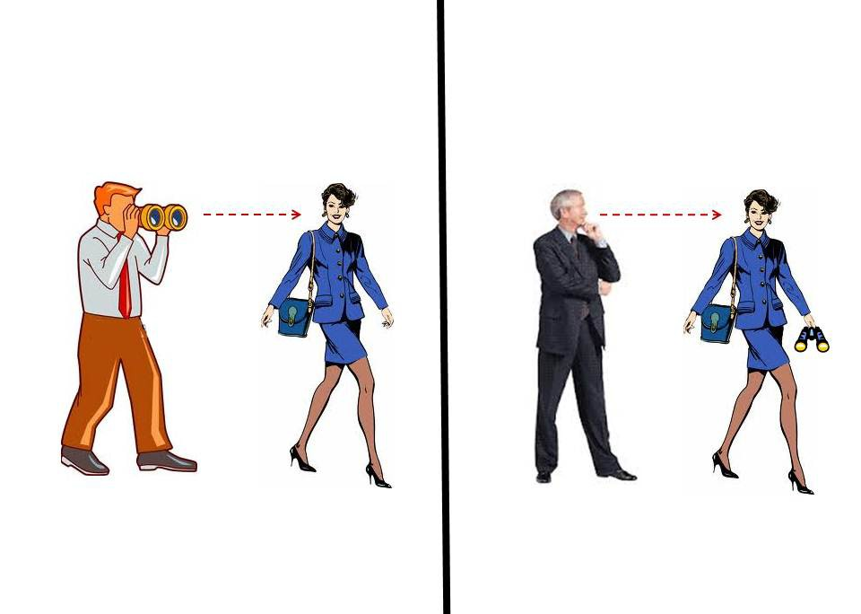
Syntactic ambiguity in sentences
Sentence
Sentence
NP
VP
NP
VP
the man
V
NP
the man
V
NP
PP
saw
NP
PP
saw
The woman
with the binoculars
the woman
with the binoculars

Slide 21
Syntactic ambiguity in sentences
Hierarchical structure
Nick Riches
Homework
Hierarchical Str
Hier.Sent.Str. Hier.Phr.Str. Embedding Hier. word str.
The following sentences are syntactically ambiguous. In what way?
Syn. Ambiguity
Syn. Ambiguity
I saw her duck.
The chickens are too hot to eat
I said I would see you on Tuesday.
Sue adores men who love women who don’t smoke.
The parents of the bride and the groom were waiting outside.
Movement
Emb. phrases
Recursion
What is recursion? Examples of recursion Characteristics of recursion Why do we need recursion?
Adv. of trees
Advantages
Trees and UG
Ideas of NC Pov. stim. UG and trees
The UG debate
Imp of rec.
Lang without rec.? Recursion in other domains? Presence of mul¹ti⁵ple^{/ 37}

Slide 22
Syntactic ambiguity in sentences
Hierarchical structure
Nick Riches
Homework
Hierarchical Str
Hier.Sent.Str. Hier.Phr.Str. Embedding Hier. word str.
I saw her duck
I saw [_{NP} her duck] / I saw [_{NP} her] [_{VP} duck]
The chickens are too hot to eat
Interpretation A; the chickens are the subject of eat, Interpretation B; the chickens are the object of eat.
I said I would see you on Tuesday.
Does on Tuesday modify the verb see or the verb say ?
Syn. Ambiguity
Syn. Ambiguity
Movement
Emb. phrases
Recursion
What is recursion? Examples of recursion Characteristics of recursion Why do we need recursion?
Adv. of trees
Advantages
Trees and UG
Ideas of NC Pov. stim. UG and trees
The UG debate
Imp of rec.
Lang without rec.? Recursion in other domains? Presence of mul¹ti⁶ple^{/ 37}

Slide 23
Syntactic ambiguity in sentences
Hierarchical structure
Nick Riches
Homework
Hierarchical Str
Hier.Sent.Str. Hier.Phr.Str. Embedding Hier. word str.
Sue adores men who love women who don’t smoke
Syn. Ambiguity
Syn. Ambiguity
Movement
Emb. phrases
Recursion
What is recursion? Examples of recursion Characteristics of recursion Why do we need recursion?
Adv. of trees
Advantages
Trees and UG
Ideas of NC Pov. stim. UG and trees
The UG debate
Imp of rec.
Lang without rec.? Recursion in other domains? Presence of mul¹ti⁷ple^{/ 37}

Slide 24
Syntactic ambiguity in sentences
Hierarchical structure
Nick Riches
Homework
Hierarchical Str
Hier.Sent.Str. Hier.Phr.Str. Embedding Hier. word str.
Sue adores men who love women who don’t smoke Sue adores non-smoking men who love women
Sue adores men who love non-smoking women Ambiguity stems from who don’t smoke - does this refer to men or women?
The parents of the bride and the groom were waiting outside.
Syn. Ambiguity
Syn. Ambiguity
Movement
Emb. phrases
Recursion
What is recursion? Examples of recursion Characteristics of recursion Why do we need recursion?
Adv. of trees
Advantages
Trees and UG
Ideas of NC
Pov. stim.
UG and trees
The UG debate
Imp of rec.
Lang without rec.? Recursion in other domains? Presence of mul¹ti⁷ple^{/ 37}

Slide 25
Syntactic ambiguity in sentences
Hierarchical structure
Nick Riches
Homework
Hierarchical Str
Hier.Sent.Str. Hier.Phr.Str. Embedding Hier. word str.
Sue adores men who love women who don’t smoke Sue adores non-smoking men who love women
Sue adores men who love non-smoking women Ambiguity stems from who don’t smoke - does this refer to men or women?
The parents of the bride and the groom were waiting outside.
[_{NP} The parents of the bride] and [_{NP} the groom] were waiting outisde
[_{NP} The parents of the bride and the groom] (i.e. both sets of parents) were waiting outside
Syn. Ambiguity
Syn. Ambiguity
Movement
Emb. phrases
Recursion
What is recursion? Examples of recursion Characteristics of recursion Why do we need recursion?
Adv. of trees
Advantages
Trees and UG
Ideas of NC
Pov. stim.
UG and trees
The UG debate
Imp of rec.
Lang without rec.? Recursion in other domains? Presence of mul¹ti⁷ple^{/ 37}

Slide 26
Hierarchical structure
Nick Riches
Homework
Hierarchical structure Syntactic ambiguity
Homework
Hierarchical Str
Hier.Sent.Str. Hier.Phr.Str. Embedding Hier. word str.
Movement Recursion
The advantages of trees
Syn. Ambiguity
Syn. Ambiguity
Movement
Emb. phrases
Recursion
What is recursion? Examples of recursion Characteristics of recursion Why do we need recursion?
Trees and Chomsky’s Universal Grammar
Adv. of trees
Advantages
The Universal Grammar debate
Trees and UG
Ideas of NC
Universal Grammar theories of language impairment
Pov. stim.
UG and trees
Bibliography
The UG debate
Imp of rec.
Lang without rec.? Recursion in other domains? Presence of mul¹ti⁷ple^{/ 37}

Slide 27
Movement of embedded phrases
Hierarchical structure
Nick Riches
Homework
label
It was [_{NP}the documentary [_{PP}on penguins]] that the man loved t
Hierarchical Str
Hier.Sent.Str. Hier.Phr.Str. Embedding Hier. word str.
NP
Syn. Ambiguity
Syn. Ambiguity
Det
N
Movement
Emb. phrases
Recursion
What is recursion? Examples of recursion Characteristics of recursion Why do we need recursion?
the
N
PP
documentary P NP
Adv. of trees
Advantages
Trees and UG
Ideas of NC
on penguins
Pov. stim.
UG and trees
The UG debate
Imp of rec.
Lang without rec.? Recursion in other domains? Presence of mul¹ti⁸ple^{/ 37}

Slide 28
Hierarchical structure
Nick Riches
Homework
Hierarchical structure Syntactic ambiguity
Homework
Hierarchical Str
Hier.Sent.Str. Hier.Phr.Str. Embedding Hier. word str.
Movement Recursion
The advantages of trees
Syn. Ambiguity
Syn. Ambiguity
Movement
Emb. phrases
Recursion
What is recursion? Examples of recursion Characteristics of recursion Why do we need recursion?
Trees and Chomsky’s Universal Grammar
Adv. of trees
Advantages
The Universal Grammar debate
Trees and UG
Ideas of NC
Universal Grammar theories of language impairment
Pov. stim.
UG and trees
Bibliography
The UG debate
Imp of rec.
Lang without rec.? Recursion in other domains? Presence of mul¹ti⁸ple^{/ 37}

Slide 29
What is recursion?
Hierarchical structure
Nick Riches
Homework Hierarchical Str
Hier.Sent.Str. Hier.Phr.Str. Embedding Hier. word str.
Syn. Ambiguity
Syn. Ambiguity
Recursion is a very important property of language.
It refers to constructions where phrases are embedded in phrases of the same type.
Movement
Emb. phrases
Recursion
What is recursion? Examples of recursion Characteristics of recursion Why do we need recursion?
Adv. of trees
Advantages
Trees and UG
Ideas of NC
Pov. stim.
UG and trees
The UG debate
Imp of rec.
Lang without rec.? Recursion in other domains? Presence of mul¹ti⁹ple^{/ 37}

Slide 30
Examples of recursion
Hierarchical structure
Nick Riches
Homework
Sentence
Hierarchical Str
Hier.Sent.Str. Hier.Phr.Str. Embedding Hier. word str.
NP
VP
D
N
V
PP
Syn. Ambiguity
Syn. Ambiguity
Your
glasses
are P
NP
Movement
Emb. phrases
on
N
PP
Recursion
What is recursion? Examples of recursion Characteristics of recursion Why do we need recursion?
the bookshelf P
NP
under
N
PP
Adv. of trees
Advantages
the clock P NP
Trees and UG
Ideas of NC
in the living rooPomv. stim.
UG and trees
The UG debate
Imp of rec.
Lang without rec.? Recursion in other domains? Presence of mul²ti⁰ple^{/ 37}

Slide 31
Examples of recursion
Hierarchical structure
Nick Riches
Homework
Sentence
Hierarchical Str
Hier.Sent.Str. Hier.Phr.Str. Embedding Hier. word str.
NP
VP
Syn. Ambiguity
Syn. Ambiguity
I
V
NP
Movement
Emb. phrases
drove
NP
NP
Recursion
What is recursion? Examples of recursion Characteristics of recursion Why do we need recursion?
N X
NP
NP
Adv. of trees
Advantages
John
’s N X N
Trees and UG
Ideas of NC Pov. stim. UG and trees
(5)
cousin ’s Car
The UG debate
Imp of rec.
Lang without rec.? Recursion in other domains? Presence of mul²ti¹ple^{/ 37}

Slide 32
Examples of recursion
Hierarchical structure
Nick Riches
Homework
Hierarchical Str
Hier.Sent.Str. Hier.Phr.Str. Embedding Hier. word str.
Sentence
NP
VP
Syn. Ambiguity
Syn. Ambiguity
John
V
Movement
Emb. phrases
Sentence
Recursion
What is recursion? Examples of recursion Characteristics of recursion Why do we need recursion?
believes
NP VP
Mary V Adj
Adv. of trees
Advantages
Trees and UG
Ideas of NC Pov. stim.
is Pregnant
(6)
UG and trees
The UG debate
Imp of rec.
Lang without rec.? Recursion in other domains? Presence of mul²ti²ple^{/ 37}

Slide 33
Characteristics of recursion
Hierarchical structure
Nick Riches
Homework
Hierarchical Str
Hier.Sent.Str. Hier.Phr.Str. Embedding Hier. word str.
And again and again. . .
Syn. Ambiguity
Syn. Ambiguity
It is on the bookshelf under the clock in the living room at
number 10 Grosvesnor street in the East End of London
Movement
Emb. phrases
Recursion
What is recursion? Examples of recursion Characteristics of recursion Why do we need recursion?
Adv. of trees
Advantages
Trees and UG
Ideas of NC
Pov. stim.
UG and trees
The UG debate
Imp of rec.
Lang without rec.? Recursion in other domains? Presence of mul²ti³ple^{/ 37}

Slide 34
Characteristics of recursion
Hierarchical structure
Nick Riches
Homework
Hierarchical Str
Hier.Sent.Str. Hier.Phr.Str. Embedding Hier. word str.
And again and again. . .
Syn. Ambiguity
Syn. Ambiguity
It is on the bookshelf under the clock in the living room at
number 10 Grosvesnor street in the East End of London
I drove John’s cousin’s auntie’s builder’s hairdresser’s car
Movement
Emb. phrases
Recursion
What is recursion? Examples of recursion Characteristics of recursion Why do we need recursion?
Adv. of trees
Advantages
Trees and UG
Ideas of NC Pov. stim. UG and trees
The UG debate
Imp of rec.
Lang without rec.? Recursion in other domains? Presence of mul²ti³ple^{/ 37}

Slide 35
Characteristics of recursion
Hierarchical structure
Nick Riches
Homework
Hierarchical Str
Hier.Sent.Str. Hier.Phr.Str. Embedding Hier. word str.
And again and again. . .
Syn. Ambiguity
Syn. Ambiguity
It is on the bookshelf under the clock in the living room at
number 10 Grosvesnor street in the East End of London
I drove John’s cousin’s auntie’s builder’s hairdresser’s car
Movement
Emb. phrases
Recursion
What is recursion? Examples of recursion Characteristics of recursion Why do we need recursion?
John believes that Sally believes that Cassandra believes
that Rufus believes that Mary is pregnant.
Adv. of trees
Advantages
Trees and UG
Ideas of NC Pov. stim. UG and trees
The UG debate
Imp of rec.
Lang without rec.? Recursion in other domains? Presence of mul²ti³ple^{/ 37}

Slide 36
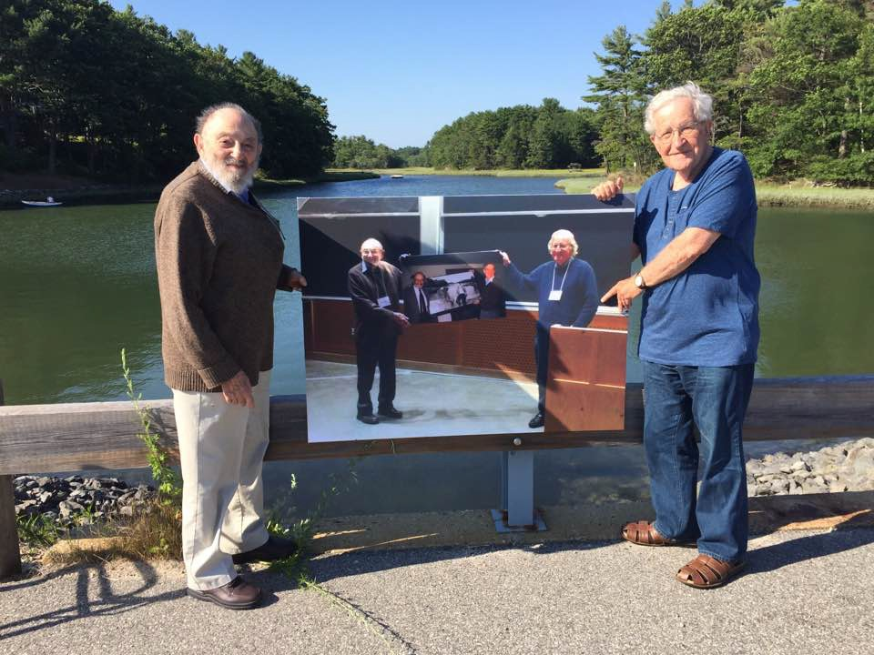
Characteristics of recursion
Hierarchical structure
Nick Riches
Homework Hierarchical Str
Hier.Sent.Str. Hier.Phr.Str. Embedding Hier. word str.
Syn. Ambiguity
Syn. Ambiguity
Movement
Emb. phrases
Recursion
What is recursion? Examples of recursion Characteristics of recursion Why do we need recursion?
Adv. of trees
Advantages
Trees and UG
Ideas of NC Pov. stim. UG and trees
The UG debate
Imp of rec.
Lang without rec.? Recursion in other domains? Presence of mul²ti⁴ple^{/ 37}

Slide 37
Why do we need recursion?
Hierarchical structure
Nick Riches
Homework
Hierarchical Str
Hier.Sent.Str. Hier.Phr.Str. Embedding Hier. word str.
Your glasses are on the bookshelf under the clock in the living room ⇒
Syn. Ambiguity
Syn. Ambiguity
Movement
Emb. phrases
Recursion
What is recursion? Examples of recursion Characteristics of recursion Why do we need recursion?
Adv. of trees
Advantages
Trees and UG
Ideas of NC Pov. stim. UG and trees
The UG debate
Imp of rec.
Lang without rec.? Recursion in other domains? Presence of mul²ti⁵ple^{/ 37}

Slide 38
Why do we need recursion?
Hierarchical structure
Nick Riches
Homework
Hierarchical Str
Hier.Sent.Str. Hier.Phr.Str. Embedding Hier. word str.
Your glasses are on the bookshelf under the clock in the
There is a clock in the living room. The bookshelf is under this. Your glasses are on that bookshelf.
living room ⇒
Syn. Ambiguity
Syn. Ambiguity
Movement
Emb. phrases
Recursion
What is recursion? Examples of recursion Characteristics of recursion Why do we need recursion?
Adv. of trees
Advantages
Trees and UG
Ideas of NC Pov. stim. UG and trees
The UG debate
Imp of rec.
Lang without rec.? Recursion in other domains? Presence of mul²ti⁵ple^{/ 37}

Slide 39
Why do we need recursion?
Hierarchical structure
Nick Riches
Homework
Hierarchical Str
Hier.Sent.Str. Hier.Phr.Str. Embedding Hier. word str.
Your glasses are on the bookshelf under the clock in the
There is a clock in the living room. The bookshelf is under this. Your glasses are on that bookshelf.
I drove John’s cousin’s car ⇒
living room ⇒
Syn. Ambiguity
Syn. Ambiguity
Movement
Emb. phrases
Recursion
What is recursion? Examples of recursion Characteristics of recursion Why do we need recursion?
Adv. of trees
Advantages
Trees and UG
Ideas of NC Pov. stim. UG and trees
The UG debate
Imp of rec.
Lang without rec.? Recursion in other domains? Presence of mul²ti⁵ple^{/ 37}

Slide 40
Why do we need recursion?
Hierarchical structure
Nick Riches
Homework
Hierarchical Str
Hier.Sent.Str. Hier.Phr.Str. Embedding Hier. word str.
Your glasses are on the bookshelf under the clock in the
There is a clock in the living room. The bookshelf is under this. Your glasses are on that bookshelf.
living room ⇒
Syn. Ambiguity
Syn. Ambiguity
Movement
Emb. phrases
I drove John’s cousin’s car ⇒
I drove a car. John has a cousin. The car belongs to the cousin.
Recursion
What is recursion? Examples of recursion Characteristics of recursion Why do we need recursion?
Adv. of trees
Advantages
Trees and UG
Ideas of NC Pov. stim. UG and trees
The UG debate
Imp of rec.
Lang without rec.? Recursion in other domains? Presence of mul²ti⁵ple^{/ 37}

Slide 41
Why do we need recursion?
Hierarchical structure
Nick Riches
Homework
Hierarchical Str
Hier.Sent.Str. Hier.Phr.Str. Embedding Hier. word str.
Your glasses are on the bookshelf under the clock in the
There is a clock in the living room. The bookshelf is under this. Your glasses are on that bookshelf.
living room ⇒
Syn. Ambiguity
Syn. Ambiguity
Movement
Emb. phrases
I drove John’s cousin’s car ⇒
I drove a car. John has a cousin. The car belongs to the cousin.
John believes Mary is pregnant⇒
Recursion
What is recursion? Examples of recursion Characteristics of recursion Why do we need recursion?
Adv. of trees
Advantages
Trees and UG
Ideas of NC
Pov. stim. UG and trees
The UG debate
Imp of rec.
Lang without rec.? Recursion in other domains? Presence of mul²ti⁵ple^{/ 37}

Slide 42
Why do we need recursion?
Hierarchical structure
Nick Riches
Homework
Hierarchical Str
Hier.Sent.Str. Hier.Phr.Str. Embedding Hier. word str.
Your glasses are on the bookshelf under the clock in the
There is a clock in the living room. The bookshelf is under this. Your glasses are on that bookshelf.
living room ⇒
Syn. Ambiguity
Syn. Ambiguity
Movement
Emb. phrases
I drove John’s cousin’s car ⇒
I drove a car. John has a cousin. The car belongs to the cousin.
John believes Mary is pregnant⇒
Recursion
What is recursion? Examples of recursion Characteristics of recursion Why do we need recursion?
Adv. of trees
Advantages
John has a belief. The following is his belief... Mary is pregnant.
Trees and UG
Ideas of NC
Pov. stim. UG and trees
The UG debate
Imp of rec.
Lang without rec.? Recursion in other domains? Presence of mul²ti⁵ple^{/ 37}

Slide 43
Hierarchical structure
Nick Riches
Homework
Hierarchical structure Syntactic ambiguity
Homework
Hierarchical Str
Hier.Sent.Str. Hier.Phr.Str. Embedding Hier. word str.
Movement Recursion
The advantages of trees
Syn. Ambiguity
Syn. Ambiguity
Movement
Emb. phrases
Recursion
What is recursion? Examples of recursion Characteristics of recursion Why do we need recursion?
Trees and Chomsky’s Universal Grammar
Adv. of trees
Advantages
The Universal Grammar debate
Trees and UG
Ideas of NC
Universal Grammar theories of language impairment
Pov. stim.
UG and trees
Bibliography
The UG debate
Imp of rec.
Lang without rec.? Recursion in other domains? Presence of mul²ti⁵ple^{/ 37}

Slide 44
Advantages
Hierarchical structure
Nick Riches
Homework
Hierarchical Str
Hier.Sent.Str. Hier.Phr.Str. Embedding Hier. word str.
We can see that trees are extremely useful means of representing sentences;
Syn. Ambiguity
Syn. Ambiguity
They can represent hierarchical structure
They can represent syntactic amiguity
They can represent movement processes and how these apply to embedded phrases
They can represent recursion
Movement
Emb. phrases
Recursion
What is recursion? Examples of recursion Characteristics of recursion Why do we need recursion?
Adv. of trees
Advantages
Trees and UG
Ideas of NC
Pov. stim.
UG and trees
The UG debate
Imp of rec.
Lang without rec.? Recursion in other domains? Presence of mul²ti⁶ple^{/ 37}

Slide 45
Hierarchical structure
Nick Riches
Homework
Hierarchical structure Syntactic ambiguity
Homework
Hierarchical Str
Hier.Sent.Str. Hier.Phr.Str. Embedding Hier. word str.
Movement Recursion
The advantages of trees
Syn. Ambiguity
Syn. Ambiguity
Movement
Emb. phrases
Recursion
What is recursion? Examples of recursion Characteristics of recursion Why do we need recursion?
Trees and Chomsky’s Universal Grammar
Adv. of trees
Advantages
The Universal Grammar debate
Trees and UG
Ideas of NC
Universal Grammar theories of language impairment
Pov. stim.
UG and trees
Bibliography
The UG debate
Imp of rec.
Lang without rec.? Recursion in other domains? Presence of mul²ti⁶ple^{/ 37}

Slide 46
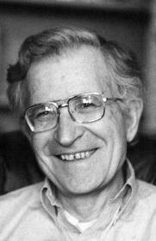
The ideas of Noam Chomsky
Hierarchical structure
Nick Riches
Homework Hierarchical Str
Hier.Sent.Str. Hier.Phr.Str. Embedding Hier. word str.
Syn. Ambiguity
Syn. Ambiguity
Movement
Emb. phrases
Recursion
What is recursion? Examples of recursion Characteristics of recursion Why do we need recursion?
Generative syntax
The main assumption of the this approach is that there is a
poverty of the stimulus
Language input is not sufficiently rich to account for children’s lingustic knowledge
Adv. of trees
Advantages
Trees and UG
Ideas of NC Pov. stim.
UG and trees
i.e. the stimulus is too poor
The UG debate
Imp of rec.
Lang without rec.? Recursion in other domains? Presence of mul²ti⁷ple^{/ 37}

Slide 47
The Poverty of the Stimulus
Hierarchical structure
Nick Riches
Homework Hierarchical Str
Hier.Sent.Str. Hier.Phr.Str. Embedding Hier. word str.
At aged 2³ children are capable of forming very complex
Syn. Ambiguity
Syn. Ambiguity
4
structures such as questions and negatives
But rudimentary mathematical abilities
Movement
Emb. phrases
Recursion
What is recursion? Examples of recursion Characteristics of recursion Why do we need recursion?
Adv. of trees
Advantages
Trees and UG
Ideas of NC Pov. stim.
UG and trees
The UG debate
Imp of rec.
Lang without rec.? Recursion in other domains? Presence of mul²ti⁸ple^{/ 37}

Slide 48
The Poverty of the Stimulus
Hierarchical structure
Nick Riches
Homework Hierarchical Str
Hier.Sent.Str. Hier.Phr.Str. Embedding Hier. word str.
At aged 2³ children are capable of forming very complex
Syn. Ambiguity
Syn. Ambiguity
4
structures such as questions and negatives
But rudimentary mathematical abilities
Movement
Emb. phrases
Recursion
What is recursion? Examples of recursion Characteristics of recursion Why do we need recursion?
⇒ we are born with an innate knowledge of language,
sometimes called Universal Grammar.
Adv. of trees
Advantages
Trees and UG
Ideas of NC Pov. stim. UG and trees
The UG debate
Imp of rec.
Lang without rec.? Recursion in other domains? Presence of mul²ti⁸ple^{/ 37}

Slide 49
Universal Grammar and trees
Hierarchical structure
Nick Riches
Homework Hierarchical Str
Hier.Sent.Str. Hier.Phr.Str. Embedding Hier. word str.
According to Chomsky, Universal Grammar is a system which is optimised for building trees
So, the trees we have drawn above provide an insight in our innate knowledge of language
Syn. Ambiguity
Syn. Ambiguity
Movement
Emb. phrases
Recursion
What is recursion? Examples of recursion Characteristics of recursion Why do we need recursion?
Adv. of trees
Advantages
Trees and UG
Ideas of NC Pov. stim. UG and trees
The UG debate
Imp of rec.
Lang without rec.? Recursion in other domains? Presence of mul²ti⁹ple^{/ 37}

Slide 50
Hierarchical structure
Nick Riches
Homework
Hierarchical structure Syntactic ambiguity
Homework
Hierarchical Str
Hier.Sent.Str. Hier.Phr.Str. Embedding Hier. word str.
Movement Recursion
The advantages of trees
Syn. Ambiguity
Syn. Ambiguity
Movement
Emb. phrases
Recursion
What is recursion? Examples of recursion Characteristics of recursion Why do we need recursion?
Trees and Chomsky’s Universal Grammar
Adv. of trees
Advantages
The Universal Grammar debate
Trees and UG
Ideas of NC Pov. stim. UG and trees
Universal Grammar theories of language impairment
Bibliography
The UG debate
Imp of rec.
Lang without rec.? Recursion in other domains? Presence of mul²ti⁹ple^{/ 37}

Slide 51
The importance of recursion
Hierarchical structure
Nick Riches
Homework
Hierarchical Str
Hier.Sent.Str. Hier.Phr.Str. Embedding Hier. word str.
In a recent article (Hauser, M. D., Fitch, W. T., & Chomsky,
N. (2002). The faculty of language: what is it, who has it, and how did it evolve? Science, 298. Click Here.) Chomsky ”lets go” of a number of different components of Universal Grammar
But they insist that recursion is a key principle.
Syn. Ambiguity
Syn. Ambiguity
Movement
Emb. phrases
Recursion
What is recursion? Examples of recursion Characteristics of recursion Why do we need recursion?
Adv. of trees
Advantages
Trees and UG
Ideas of NC
Pov. stim.
UG and trees
The UG debate
Imp of rec.
Lang without rec.? Recursion in other domains? Presence of mul³ti⁰ple^{/ 37}

Slide 52
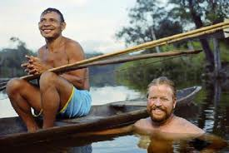
A language without recursion?
Hierarchical structure
Nick Riches
Homework Hierarchical Str
Hier.Sent.Str. Hier.Phr.Str. Embedding Hier. word str.
Syn. Ambiguity
Syn. Ambiguity
Movement
Emb. phrases
Recursion
What is recursion? Examples of recursion Characteristics of recursion Why do we need recursion?
Adv. of trees
Advantages
Daniel Everett
Pirah˜a language does not actually contain recursion
Trees and UG
Ideas of NC Pov. stim.
UG and trees
The UG debate
Imp of rec.
Lang without rec.? Recursion in other domains? Presence of mul³ti¹ple^{/ 37}

Slide 53
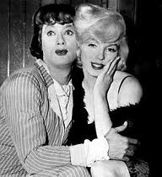
Recursion in other domains?
Hierarchical structure
Nick Riches
Homework Hierarchical Str
Hier.Sent.Str. Hier.Phr.Str. Embedding Hier. word str.
Syn. Ambiguity
Syn. Ambiguity
Movement
Emb. phrases
Recursion
What is recursion? Examples of recursion Characteristics of recursion Why do we need recursion?
Adv. of trees
Advantages
Marilyn Monroe’s character thinks [ that Tony Curtis’s character (Joe) is a woman called Josephine ]
We therefore mentally represent the situation described by the recursive sentence Marilyn believes that Josephine is a
Trees and UG
Ideas of NC Pov. stim. UG and trees
The UG debate
Imp of rec.
woman
Lang without rec.?
Recursion in other domains? Presence of mul³ti²ple^{/ 37}

Slide 54
Recursion in other domains?
Hierarchical structure
Nick Riches
Homework
Hierarchical Str
Hier.Sent.Str. Hier.Phr.Str. Embedding Hier. word str.
Concepts involving recursion
Syn. Ambiguity
Syn. Ambiguity
Movement
Emb. phrases
Recursion
What is recursion? Examples of recursion Characteristics of recursion Why do we need recursion?
Adv. of trees
Advantages
Trees and UG
Ideas of NC Pov. stim. UG and trees
The UG debate
Imp of rec.
Lang without rec.?
Recursion in other domains?
Presence of mul³ti³ple^{/ 37}

Slide 55
Recursion in other domains?
Hierarchical structure
Nick Riches
Homework
Hierarchical Str
Hier.Sent.Str. Hier.Phr.Str. Embedding Hier. word str.
Concepts involving recursion
Pregnancy (a person inside a person)
Russian dolls (a doll inside a doll inside a doll inside a doll, etc.)
Postal addresses (1 Smith Street, Covington, Berkshire, England, Europe, the Northern Hemisphere, the World, the Solar System, the Milky Way, the Universe, the Multiverse).
Syn. Ambiguity
Syn. Ambiguity
Movement
Emb. phrases
Recursion
What is recursion? Examples of recursion Characteristics of recursion Why do we need recursion?
Adv. of trees
Advantages
Trees and UG
Ideas of NC Pov. stim. UG and trees
The UG debate
Imp of rec.
Lang without rec.? Recursion in other domains? Presence of mul³ti³ple^{/ 37}

Slide 56
Presence of multiple recursion in spoken language
Hierarchical structure
Nick Riches
Homework
Hierarchical Str
Hier.Sent.Str. Hier.Phr.Str. Embedding Hier. word str.
Theoreticaly, we can say John believes that Sally believes that Cassandra believes that Rufus believes that Mary is pregnant
I drove John’s cousin’s auntie’s builder’s hairdresser’s car
But do we actually do this?
Syn. Ambiguity
Syn. Ambiguity
Movement
Emb. phrases
Recursion
What is recursion? Examples of recursion Characteristics of recursion Why do we need recursion?
Adv. of trees
Advantages
Trees and UG
Ideas of NC Pov. stim. UG and trees
The UG debate
Imp of rec.
Lang without rec.? Recursion in other domains? Presence of mul³ti⁴ple^{/ 37}

Slide 57
Hierarchical structure
Nick Riches
Homework
Hierarchical structure Syntactic ambiguity
Homework
Hierarchical Str
Hier.Sent.Str. Hier.Phr.Str. Embedding Hier. word str.
Movement Recursion
The advantages of trees
Syn. Ambiguity
Syn. Ambiguity
Movement
Emb. phrases
Recursion
What is recursion? Examples of recursion Characteristics of recursion Why do we need recursion?
Trees and Chomsky’s Universal Grammar
Adv. of trees
Advantages
The Universal Grammar debate
Trees and UG
Ideas of NC
Universal Grammar theories of language impairment
Pov. stim.
UG and trees
Bibliography
The UG debate
Imp of rec.
Lang without rec.? Recursion in other domains? Presence of mul³ti⁴ple^{/ 37}

Slide 58
Hierarchical structure
Nick Riches
Homework
Hierarchical Str
Hier.Sent.Str. Hier.Phr.Str. Embedding Hier. word str.
Rice & Wexler’s ”ATOM” model; Universal Grammar mechanisms governing realisation of tense and case-marking are ‘broken’ (Rice, Wexler & Redmond, 1999)
Syn. Ambiguity
Syn. Ambiguity
(7) Him go there
Movement
Emb. phrases
Recursion
What is recursion? Examples of recursion Characteristics of recursion Why do we need recursion?
Van der Lely’s Computational Grammatical Complexity Acccount (van der Lely & Pinker, 2014)
Adv. of trees
Advantages
(8) The dog was chased by the cat
Trees and UG
Ideas of NC Pov. stim. UG and trees
The UG debate
Imp of rec.
Lang without rec.? Recursion in other domains? Presence of mul³ti⁵ple^{/ 37}

Slide 59
Hierarchical structure
Nick Riches
Homework
Hierarchical Str
Hier.Sent.Str. Hier.Phr.Str. Embedding Hier. word str.
What grammatical characteristic do the following song lyrics have in common.
When I fall in love, it will be forever (sung by Nat King Cole)
Wherever I lay my hat, that’s my home (sung by Marvin Gaye)
Whenever/wherever we’re meant to be together, I’ll be there and you’ll be near (sung by Shakira)
Syn. Ambiguity
Syn. Ambiguity
Movement
Emb. phrases
Recursion
What is recursion? Examples of recursion Characteristics of recursion Why do we need recursion?
Adv. of trees
Advantages
Trees and UG
Ideas of NC Pov. stim. UG and trees
The UG debate
Imp of rec.
Lang without rec.? Recursion in other domains? Presence of mul³ti⁶ple^{/ 37}

Slide 60
Hierarchical structure
Nick Riches
Homework
Hierarchical structure Syntactic ambiguity
Homework
Hierarchical Str
Hier.Sent.Str. Hier.Phr.Str. Embedding Hier. word str.
Movement Recursion
The advantages of trees
Syn. Ambiguity
Syn. Ambiguity
Movement
Emb. phrases
Recursion
What is recursion? Examples of recursion Characteristics of recursion Why do we need recursion?
Trees and Chomsky’s Universal Grammar
Adv. of trees
Advantages
The Universal Grammar debate
Trees and UG
Ideas of NC
Universal Grammar theories of language impairment
Pov. stim.
UG and trees
Bibliography
The UG debate
Imp of rec.
Lang without rec.? Recursion in other domains? Presence of mul³ti⁶ple^{/ 37}

Slide 61
Hierarchical structure
Nick Riches
Homework
Hierarchical Str
Hier.Sent.Str. Hier.Phr.Str. Embedding Hier. word str.
Rice, M. L., K. Wexler, and S. M Redmond. Grammaticality Judgments of an Extended Optional Infinitive Grammar: Evidence from English-Speaking Children with Specific Language Impairment. Journal of Speech, Language, and Hearing Research 42, no. 4 (1999): 943-61.
Lely, Heather K.J. van der, and Steven Pinker. The Biological Basis of Language: Insight from Developmental Grammatical Impairments. Trends in Cognitive Sciences 18, no. 11 (November 2014): 586-95. https://doi.org/10.1016/j.tics.2014.07.001.
Syn. Ambiguity
Syn. Ambiguity
Movement
Emb. phrases
Recursion
What is recursion? Examples of recursion Characteristics of recursion Why do we need recursion?
Adv. of trees
Advantages
Trees and UG
Ideas of NC
Pov. stim.
UG and trees
The UG debate
Imp of rec.
Lang without rec.? Recursion in other domains? Presence of mul³ti⁷ple^{/ 37}

